Slide 1
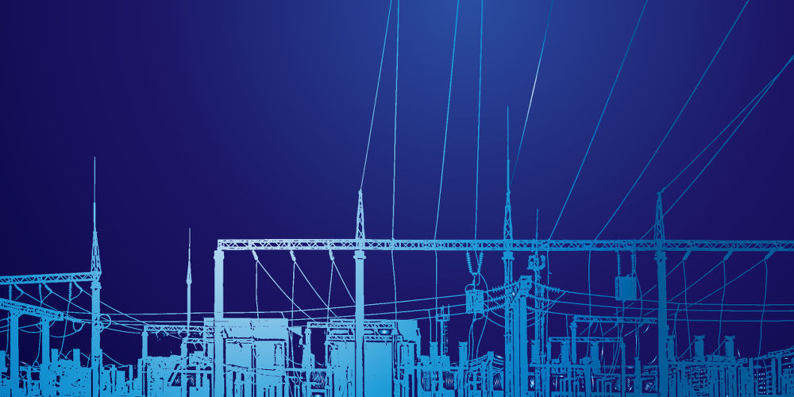
Project Presentation
EEE 306
Power System Laboratory
Group: 06

Slide 2
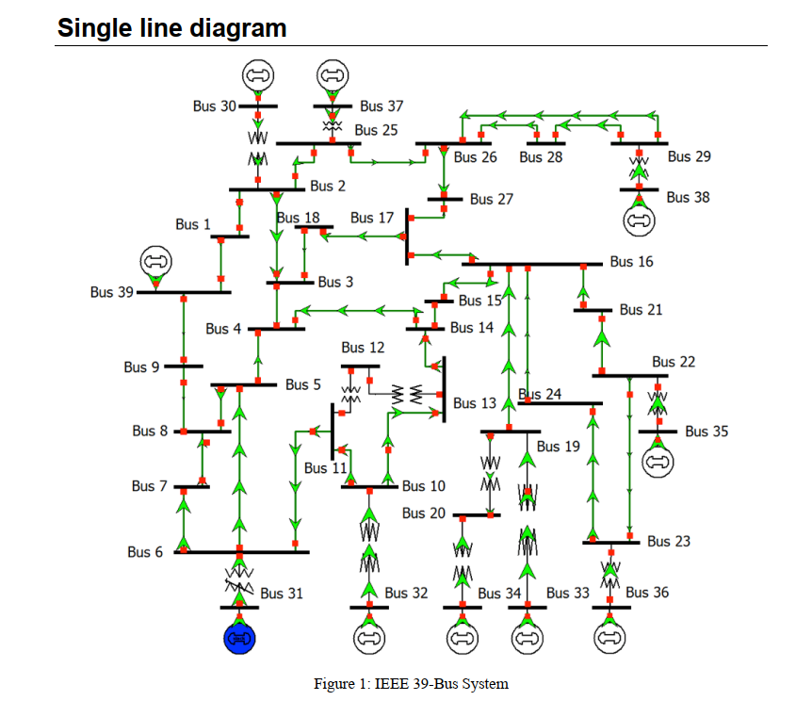
Load Flow Analysis on
IEEE 39 Bus System at 50Hz

Slide 3
Solution Steps
Simulating the system with Given Data , with out any DC Line, Induction Motors, TCUL Xmer
Step 01:
Simulation result
No Overloading Occurred.
Couple of Line underloading and under loaded Transformer was observed

Slide 4
Simulating the system with Given Data , with a DC Line, Induction Motors, TCUL Xmer, Removing L15 AC line
Step 02:
Simulation result
Some bus was out of their voltage limit
At L22, L14, L17,l07,L18,L09 line Overloading Occurred.
Transformer 03 was highly overloaded
G03,G06,G07 crossed their Reactive Limits

Slide 5
Step 03:
To solve Generators at reactive limits problem, one SVC was connected B23
Simulation result
No Gen has crossed their Reactive Limits
Some bus was out of their voltage limit
Transformer 03 was overloaded as before
Line Overloading remained same
Explanation
Generator 07, connected at B23, were consuming highly reactive power than reactive limits. SVC can absorb or deliver reactive power . So, one SVC was connected at B23. G07 problem was solved as well as G03,G06.

Slide 6
Step 04:
To solve bus out of voltage limit , One SVC was connected B09
Simulation result
No Gen has crossed their Reactive Limits
No buses were out of their voltage limits
Transformer 03 was overloaded as before
Line Overloading L22, L07, L18,L09
Explanation
Some buses were out of voltage limits. There voltage (pu) was less than minimum. So , SVC was connected at B09, to deliver reactive power . Thus, bus voltage increased and problems are solved.

Slide 7
Step 05:
To solve the transformer overloading problem, active generation of G01, G03, G10 was increased by 50MW.
Simulation result
No Transformer overloading problem was occured
Line Overloading remains same L22, L07, L09
T03 was connected between B31 and B06. Again, B31 is slack bus. Again, B06 is very closed to B31. So, high power is flowing through T03. To solve this, we have to increase the generation of some other generator, to release pressure of swing generator
Explanation

Slide 8
Step 06:
To solve line overloading problem , two more svc was connected at B04 and B05
Simulation result
Line overloading problem solved at L07
Line Overloading remains same as L22, L09
Explanation
L07 was connected between B04 and B05, So, we have attached SVC at both side

Slide 9
Step 07:
To solve L22 and L09 overloading problem we have increased the loading limit of L09 up to 1200,and L22 at 1800
After this step, only line underloading and transformer underloading was remained
By decreasing the loading limit of line , under loading problem of line was also solved
Simulation result

Slide 10
Contributions
1706150: Data entry
1706145: Data entry and cross-checking
1706149: Placing corrective devices and problems solving and making presentation slide
1706189:Placing corrective devices and problems solving

Slide 11
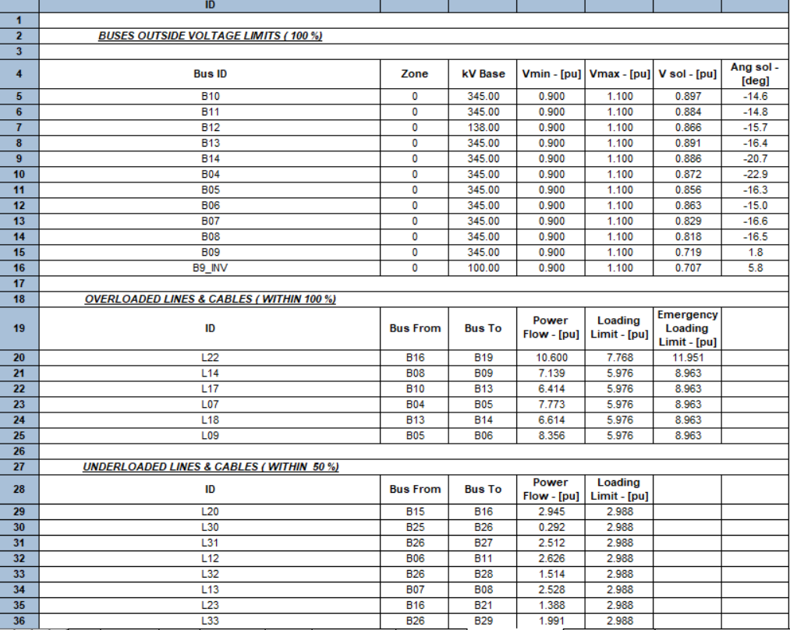
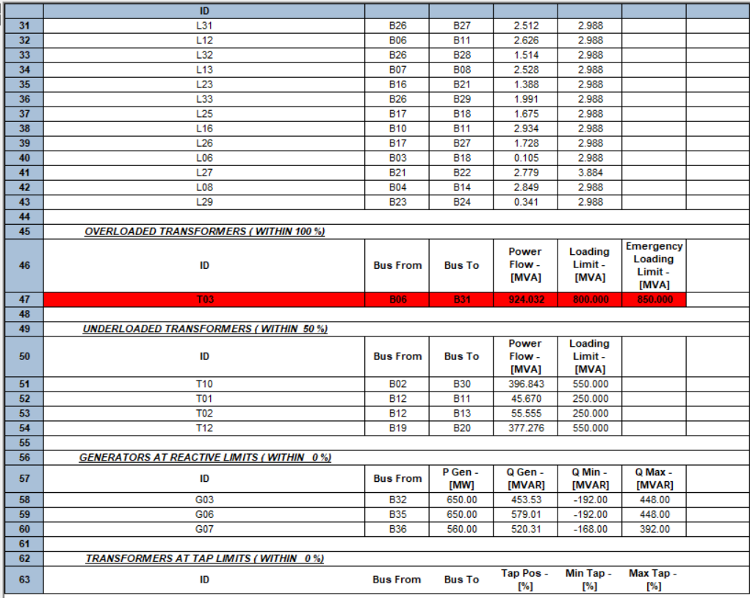
After
Step 02

Slide 12
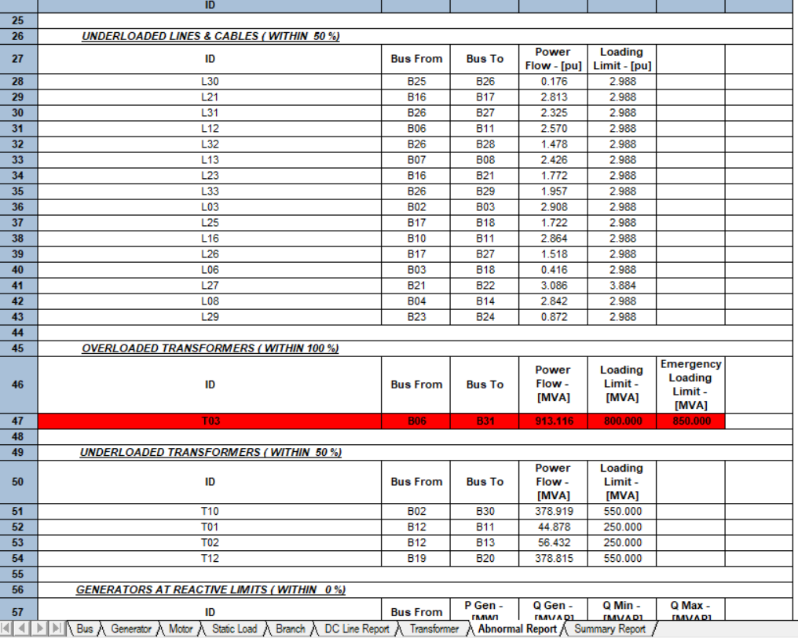
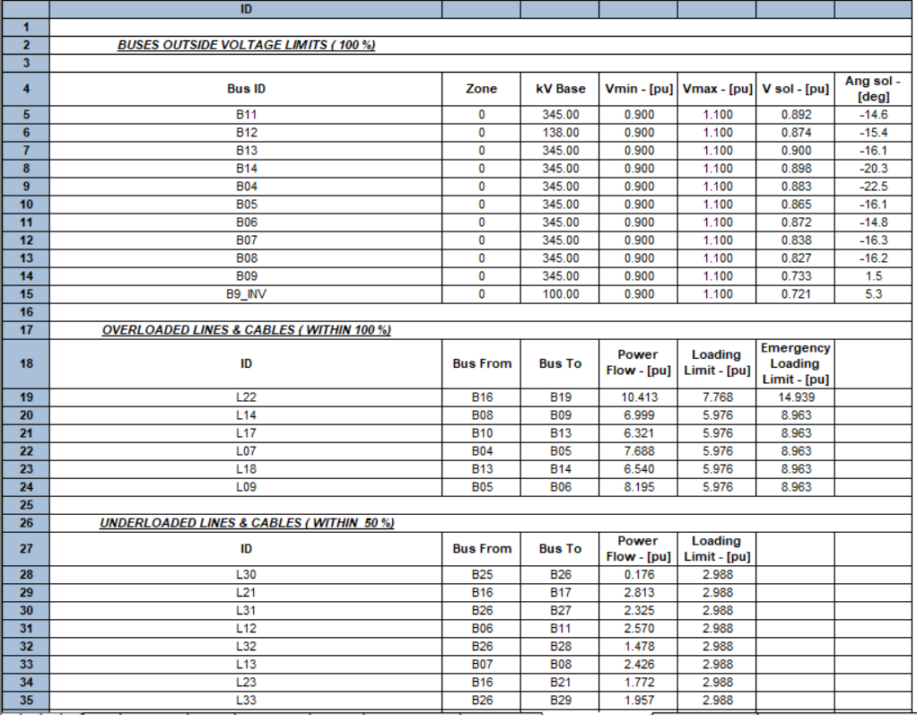
After
Step 03

Slide 13
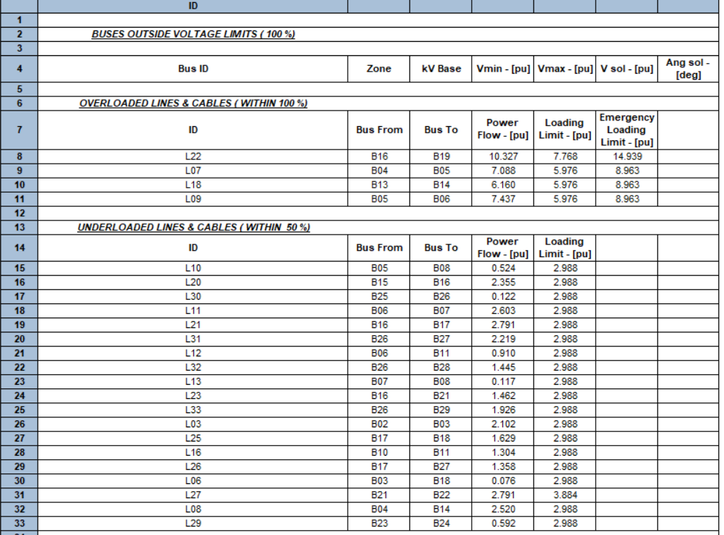
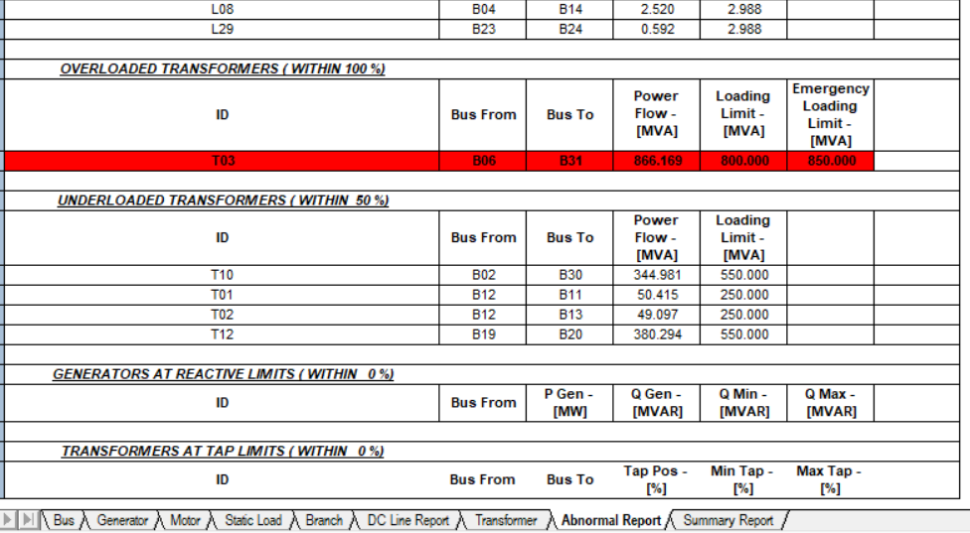
After
Step 04

Slide 14
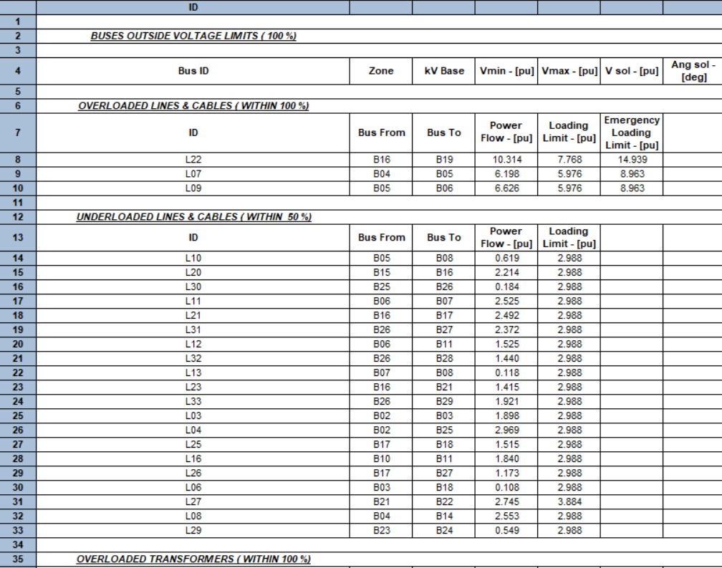
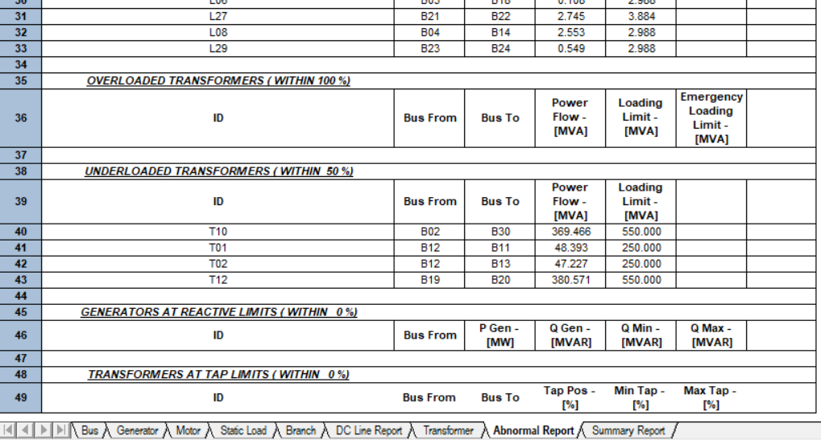
After
Step 05

Slide 15
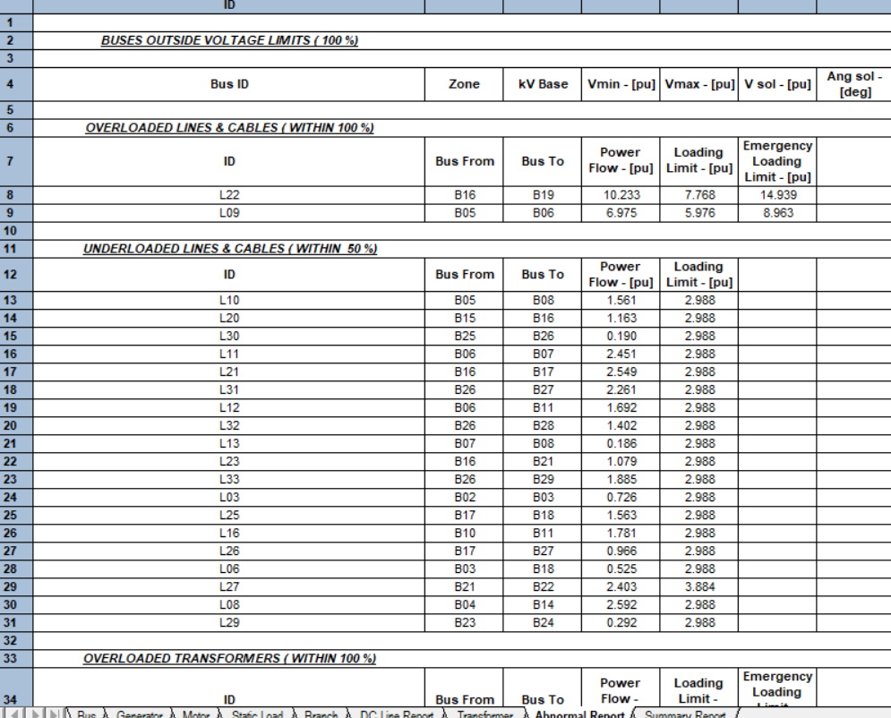
After
Step 06

Slide 16
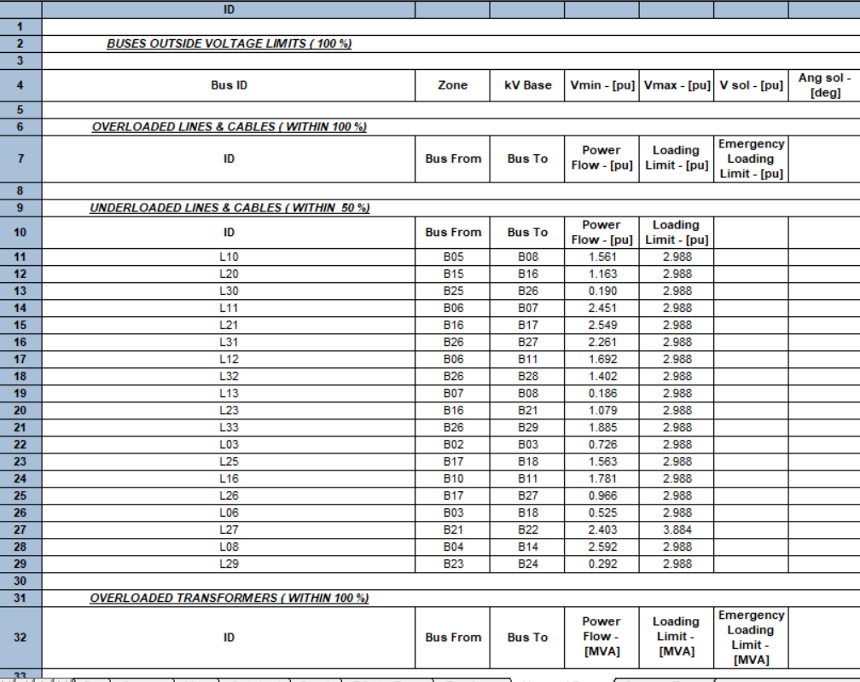
After step 07

